Slide 1
JavaScript To TypeScript
@basarat

Slide 2
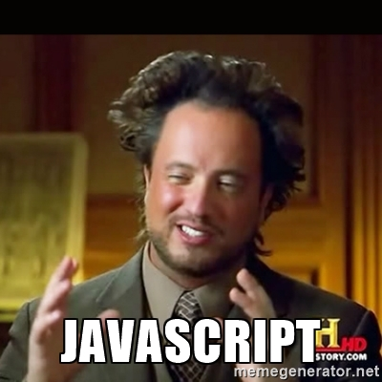

Slide 3
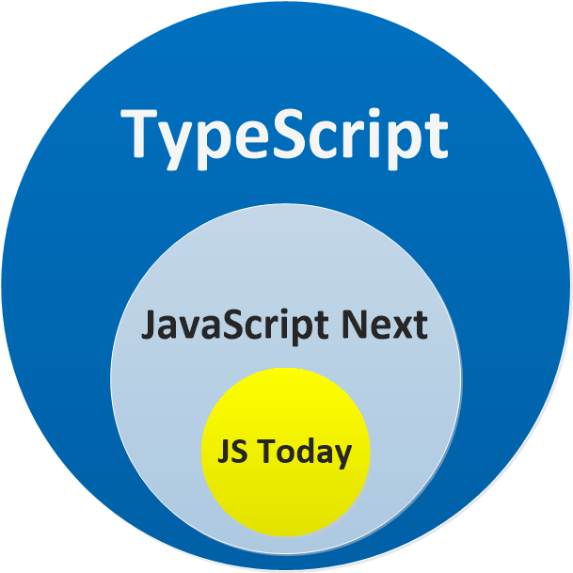

Slide 4
DEMO
Just a JS file

Slide 6


Slide 7


Slide 8


Slide 10
QUESTIONS

Slide 11


alm.tools
Google:
TypeScript Book
https://egghead.io/instructors/basarat-ali-syed

Slide 12
@basarat

